Slide 1


RESELLER DW INTEGRATION
By
Team 9
Akshaya Suresh
Rishabh Jain
Rishika Dawkar

Slide 2

Contents
System Of Records (All sources)
Target Datawarehouse (Retail)
Observations in SOR
Data Profiling
Reject Codes and Error Handling
Currency Calculation
SCDs

Slide 3
System Of Records
RETAIL_SOR_AS (Oracle) – 19 tables
RETAIL_SOR_NA (MySQL) – 19 tables
RETAIL_SOR_EU (SqlServer) – 19 tables
RETAIL_SOR_CAT (Postgres) – 12 tables
RETAIL_SOR_PLAN (MySQL) – 2 tables
CSVs, Excel Sheets (Tab delaminated, comma delaminated) – 25

Slide 4
Target Datawarehouse
RETAIL_DW (Oracle)
30 Tables
19 Dimensions
11 Facts
Four Channels (Online, Store, Catalog, Resellers)
Three Scenarios ( Forecast, Budget, Actuals)

Slide 5
Observations in SOR
Different unique key for product’s table across all SORs e.g. ProductID, BrandID, ProductLabel
Length of the values were different across SORs
Data type for dates in the CSV and TXT files are not constant.

Slide 6
Data Profiling
Changed the SOR Load and Update dates from TIMESTAMP to DATE for Oracle and PostgreSQL to load SOR_LOADDATE
Converted data type values for DATES to DATE data type across all the CSVs and Text input files
For SCDs DimProductPrice and DimProductCost we had to use SOR dimproduct (MySQL) as a bridge between input file price_cny_step_1_of_4 and DIMPRODUCT
Converted all the possible columns in the target metadata from Big Decimal to INT
Data Type csv contains all the column’s data type which we kept constant across all the SORs and Target table depending upon the size of data
Had to append zeros and trimmed values in the for joining product tables

Slide 7
Reject Codes and Error Handling
Reject Codes are used to catch bad data, missing values or invalid data present in the facts rejects
Reject Reasons help you understand the bad data in detail

Slide 8
Reject Codes and Error Handling
Handled null values using Relation.ISNULL function and applied code 99 if nulls are found
Refer Error handling document for more details

Slide 9
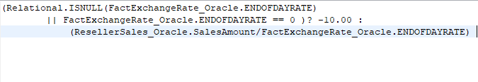
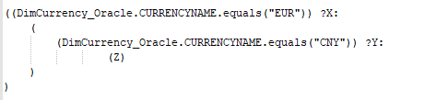
Currency Calculation X and Y depends on the current rate of the currency against USD

Slide 10
SCDs
SCDs stands for Slowly Changing Dimensions
SCDs are used in the data integration to track changing values of unit cost and unit price
SCD TYPE 2 is implemented to integrate the tables DIMPRODUCTPRICE and DIMPRODUCTCOST

Slide 11
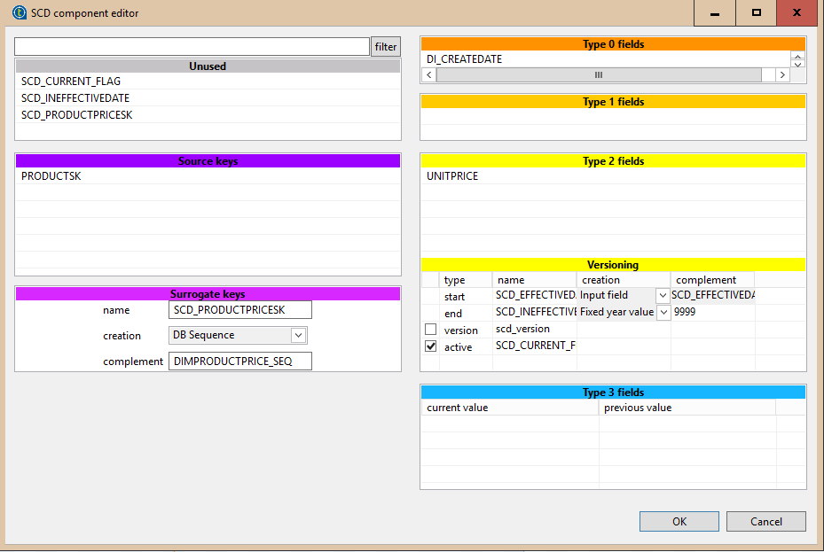
SCDs
Refer Scd Example document for more details

